Slide 1
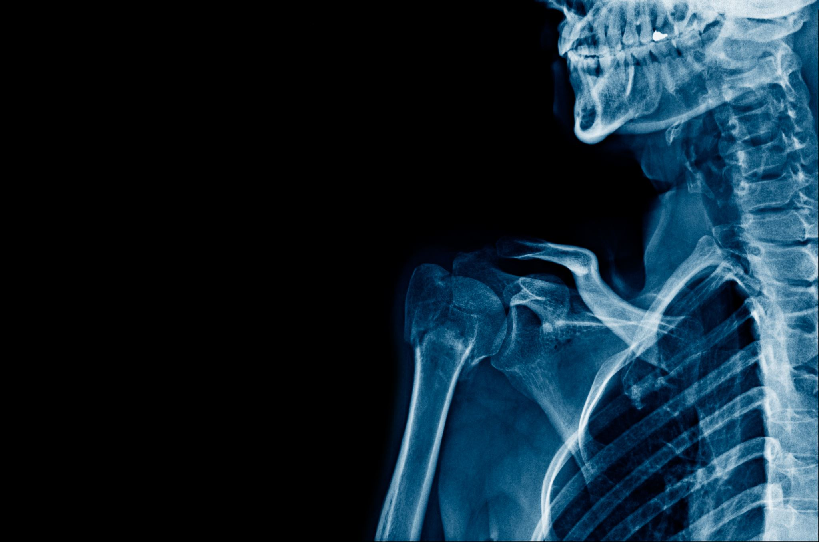
Orthopedic Prediction Project
Sebastian Tagle, Katherine Layton, Johnny Ramirez, and Cody Carpenter

Slide 2
Project Overview
Data Selection
Usefulness of Results
How it Relates to All Data Scientists

Slide 3
Attributes of Consideration
Pelvic Incidence
Pelvic Tilt
Lumbar Lordosis Angle
Sacral Slope
Pelvic Radius
Grade of Spondylolithesis

Slide 4
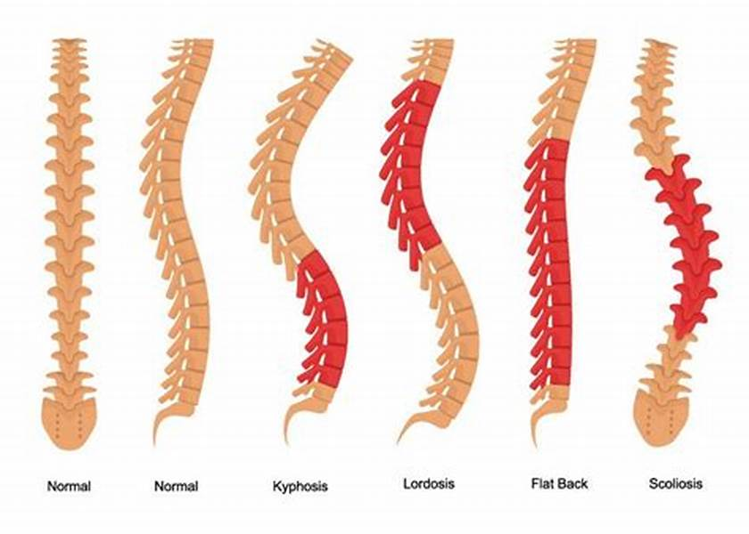
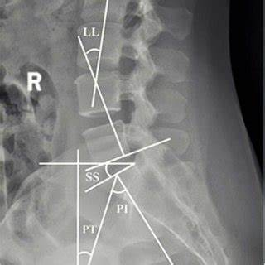
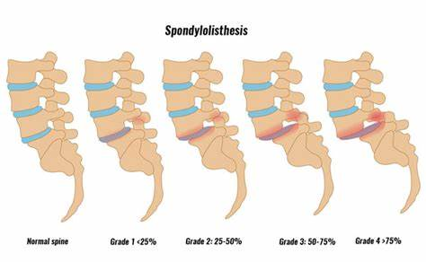
What are we referring to?

Slide 5
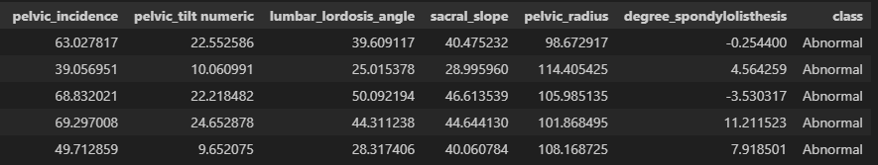
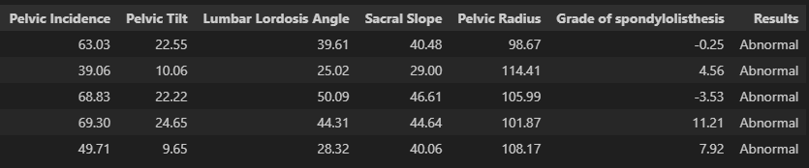
Clean the Dataset
The first task is to reorganize the dataset of 310 patients with 6 different parameters.
Organize the data with the column names.
We didn’t need 8 decimals per value, so we reduce to 2 decimals.

Slide 6
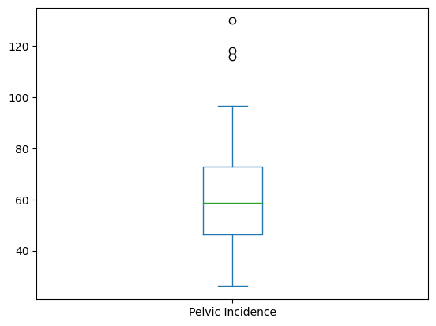
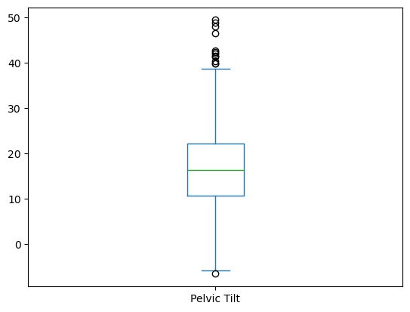
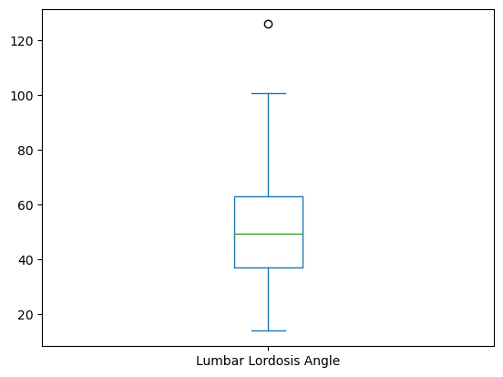
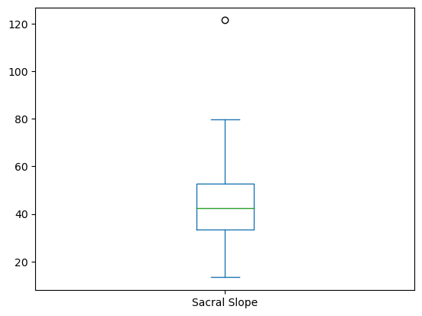
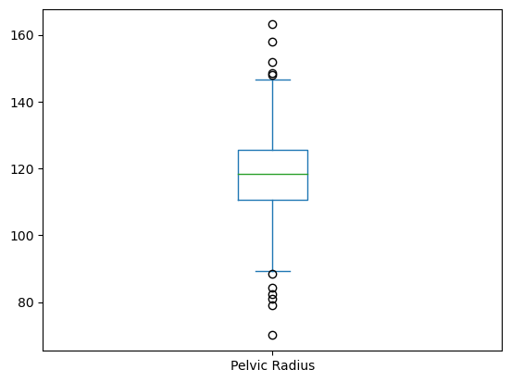
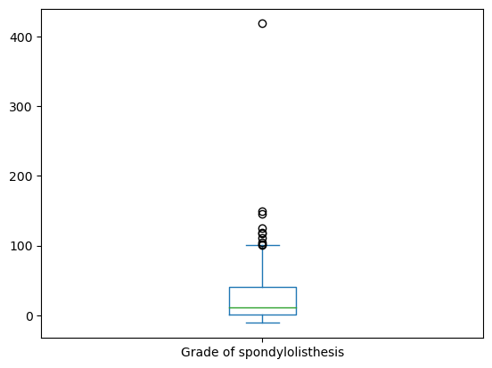
Can we use Machine Learning?
We need to see if we can explain the abnormal situation with one paramater by itself or if we need all the parameters to explain the Spondylolithesis of Disc Herniation.

Slide 7
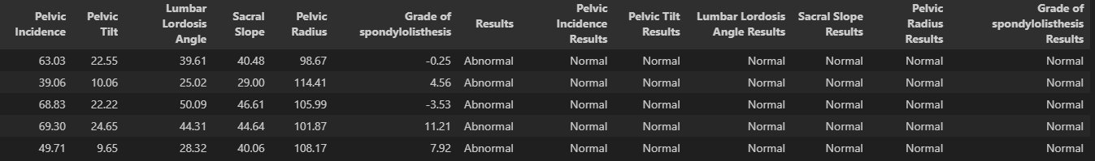
Can we use Machine Learning?
We need to have every parameter to explain or to say that this patient has a disc herniation

Slide 8
Application of Results
Medical studies and supportive literature.
Relation to project results.
Notes:
In a study completed by the The Journal of Bone and Joint Surgery they found that “Study of twenty skeletons and two hundred patients with degenerative spondylolisthesis established that it occurred four times more frequently in females, six to nine times more frequently at the interspace between the fourth and fifth lumbar vertebrae than at adjoining levels, three times more frequently in blacks than in whites, and four times more frequently the fifth lumbar vertebra was sacralized”Rosenberg, 1975.
Background: Prolonged sitting posture as in computer users is harmful to the spine and may lead to posture abnormalities, which are due to changes in spinal mobility, leading to changes of back functional stability and mobility. Purpose: to investigate the effect of prolonged sitting posture on lumbar range of motion (LROM) in computer users. Material and methods: thirty-two adult computer users of both sexes participated in this study. Their age ranged from 20 to 35 years, with no musculoskeletal diseases or current spinal pain. Group A: "16" participants were using computer from 8 to 10 years, divided into: A1: 8 participants were using computer more than 5 hours daily. A2: 8 participants were using computer from 2 to 5 hours daily. Group B: "16" participants were using computer from 2 to 4 years, divided into: B1: 8 participants were using computer more than 5 hours daily. B2: 8 participants were using computer from 2 to 5 hours daily. Back range of motion device (BROM II) was used to evaluate LROM. Results: Two-way MANOVA was conducted to investigate the effect of years and daily hours of computer usage on all lumbar range of motion. Two-way MANOVA showed a significant effect of years of computer usage on lumbar flexion, extension, right lateral flexion, left lateral flexion and left rotation ROM. A significant effect of daily hours of computer usage was found on lumbar extension ROM, while there was no significant effect of daily hours of
computer usage on other ROM measurements. There was no significant interaction effect of years and daily hours of computer usage on lumbar flexion (p = 0.24), extension (p = 0.26), right lateral flexion (p = 0.73), left lateral flexion (p = 0.54), right rotation (p = 0.61) and left rotation ROM (p = 0.1). Conclusion: the effect of prolonged sitting posture on LROM in computer users varies according to the daily hours and number of years of computer usage.

Slide 9
Bibliography
Alkan, H., & Yenişehir, S. (2022). Investigation of Factors Associated With Pain Intensity in Office Workers With Non-Specific Low Back Pain. Pain Management Nursing, 23(6), 819-825.
Bolesta, M. J., Winslow, L., & Gill, K. (2010). A comparison of film and computer workstation measurements of degenerative spondylolisthesis: intraobserver and interobserver reliability. Spine, 35(13), 1300-1303.
Rosenberg, N. J. (1975). Degenerative spondylolisthesis. Predisposing factors. JBJS, 57(4), 467-474.
Sallam, S. A., Kattabei, O., Kholaif, A., Abu Taleb, E., Hassan, A. M., & Abdelhamid, A. S. (2022). Influence of Prolonged Sitting Posture on lumbar range of motion in computer users. South Valley University International Journal of Physical Therapy and Sciences, 3(1), 1-12.

